Slide 1


Practice Problem

Slide 2
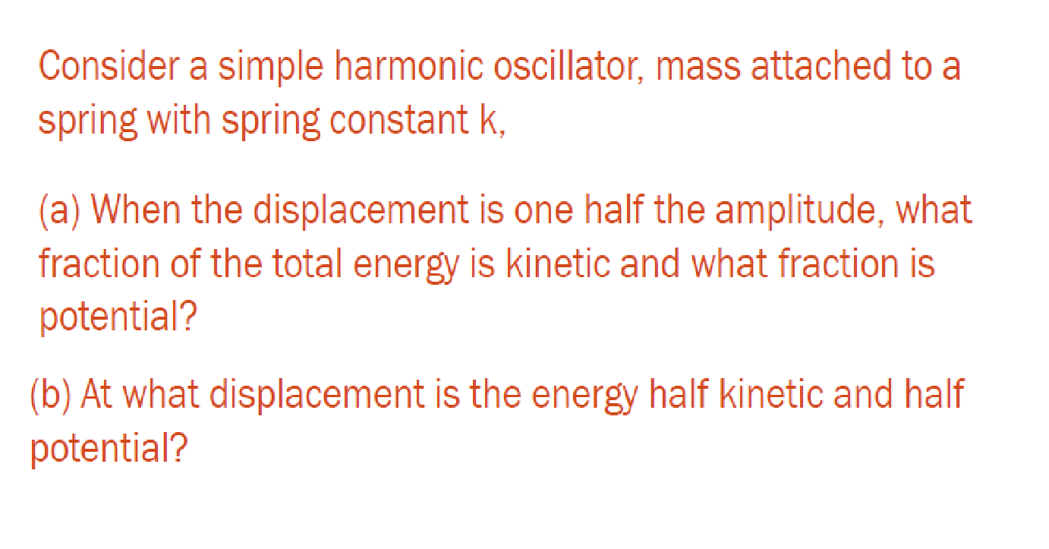

Slide 3
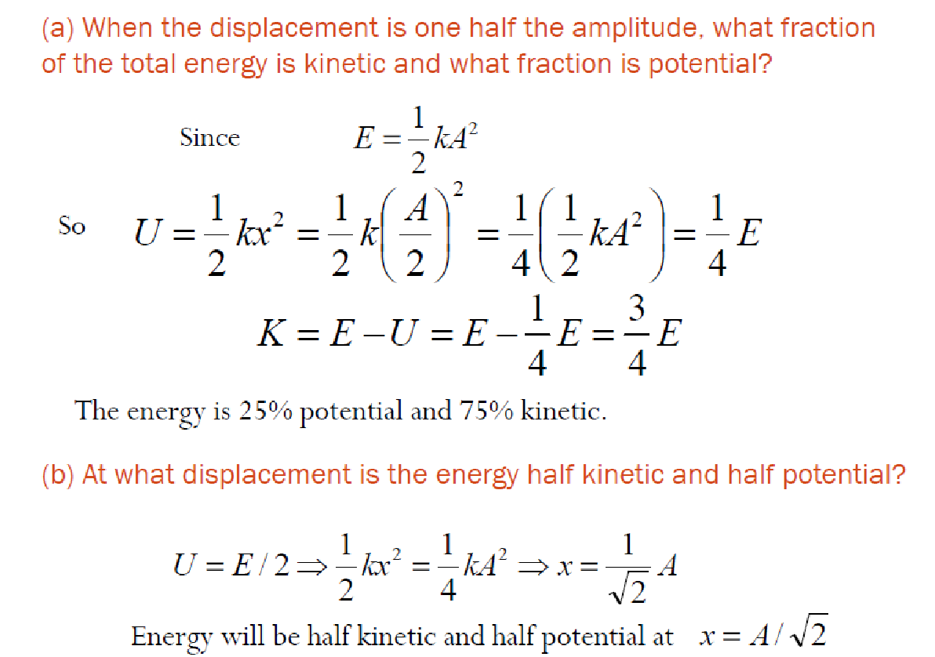

Slide 4


Slide 5
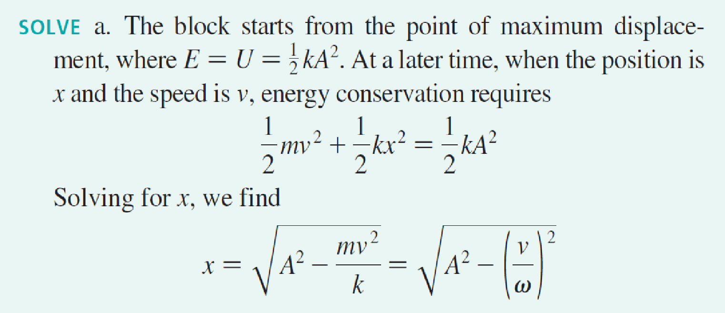


Slide 6
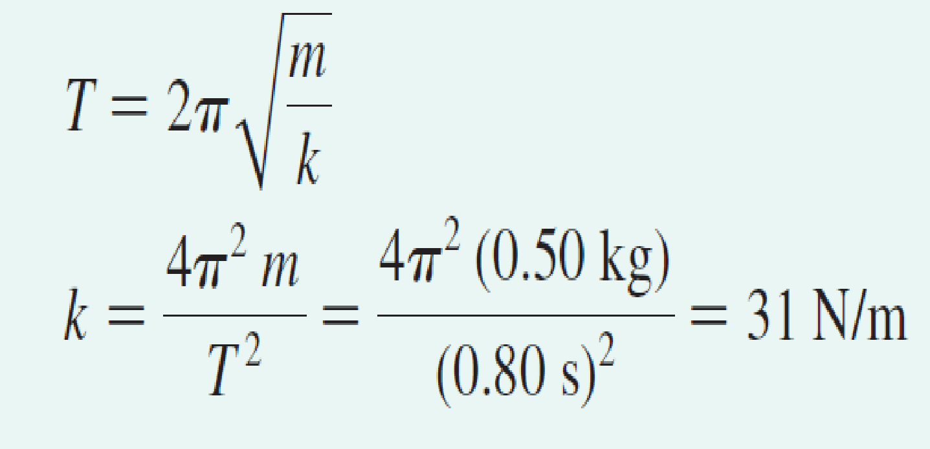

Slide 7
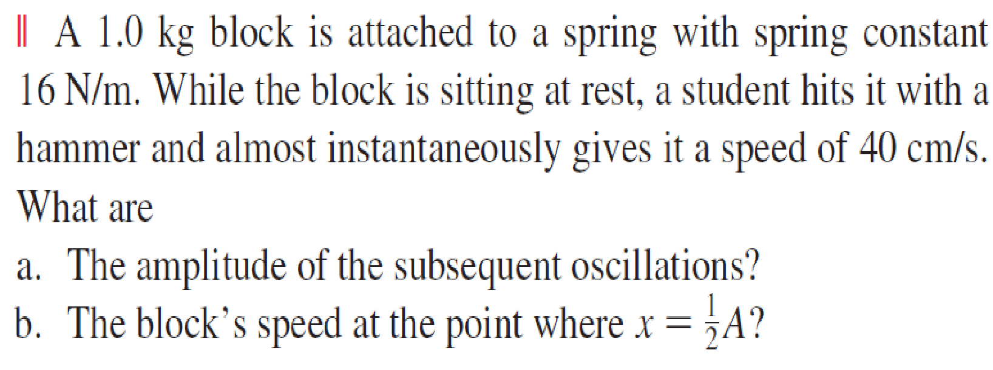

Slide 8
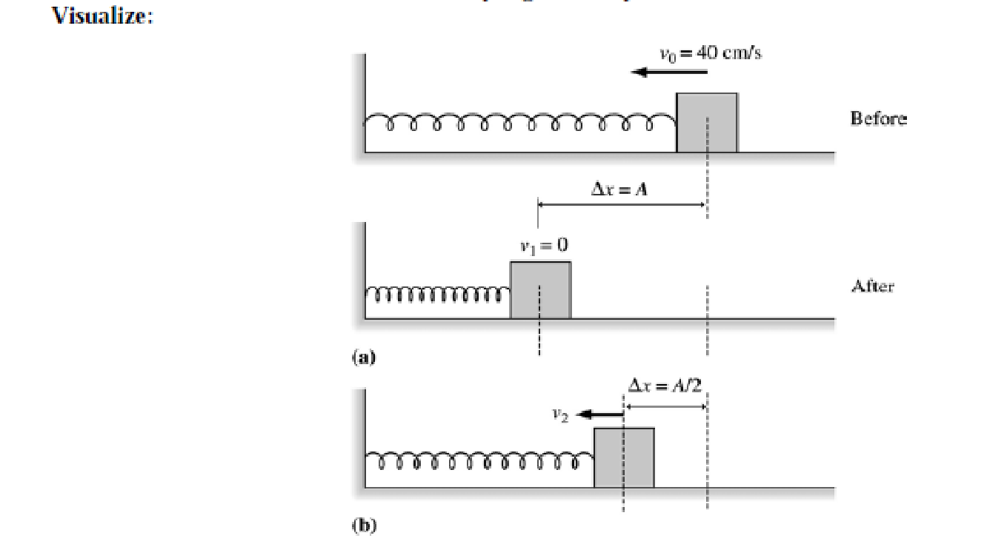

Slide 9
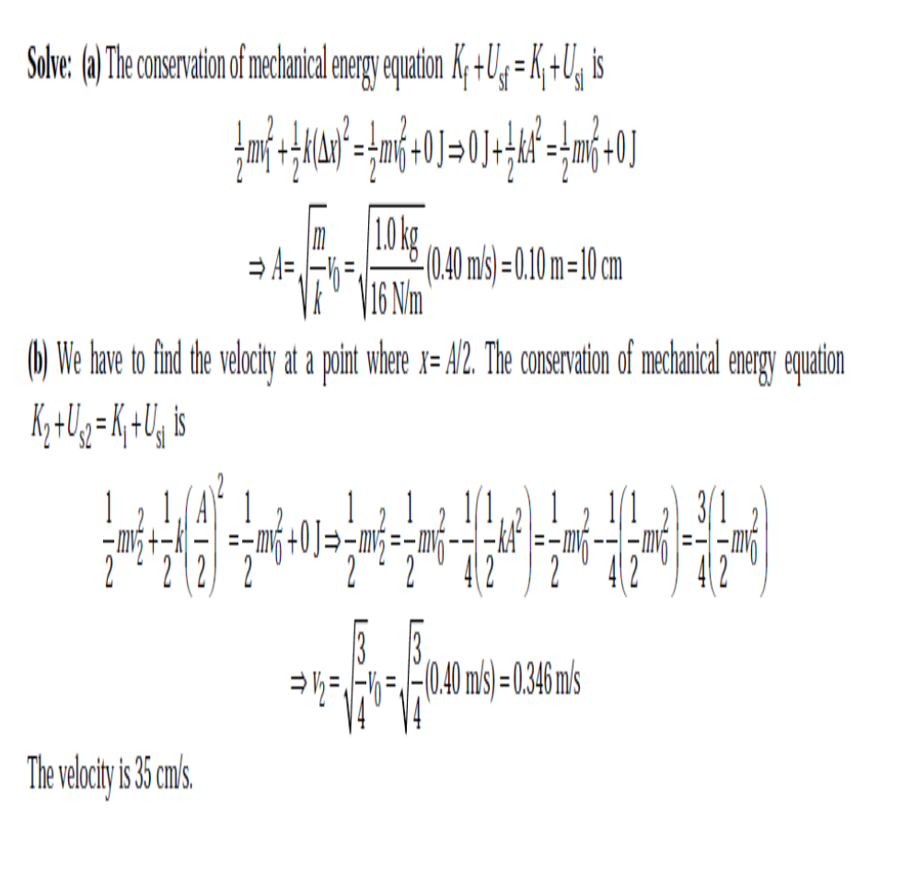

Slide 10
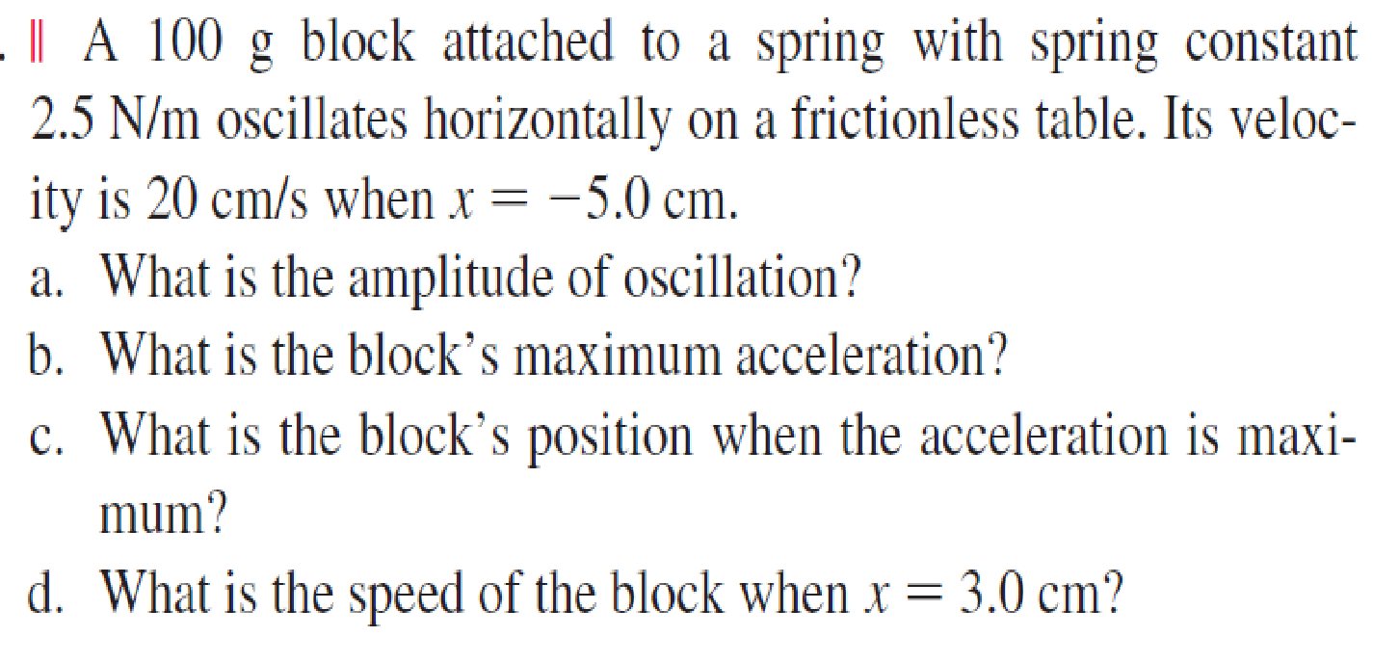

Slide 11




Slide 12

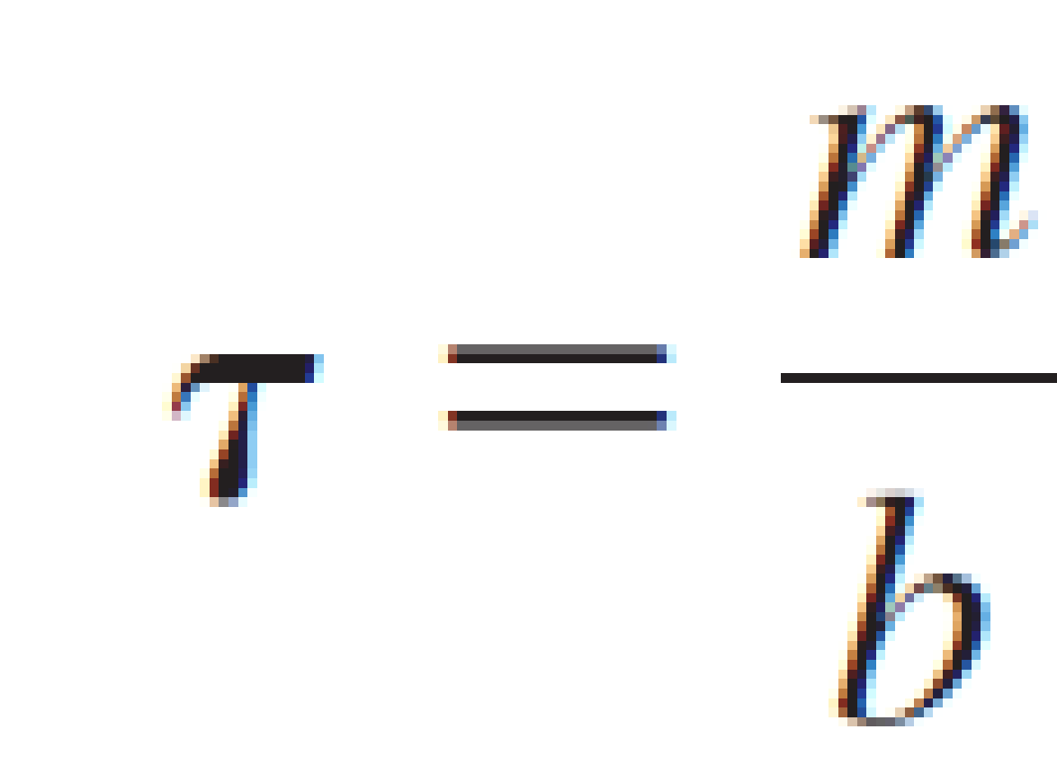


Energy in Damped Systems
When considering the oscillator’s mechanical energy, it is useful to define the time constant (also called the decay time) to be
With this we can write oscillation amplitude
the mechanical energy is no longer conserved. At any particular time we can compute the mechanical energy from

Slide 13
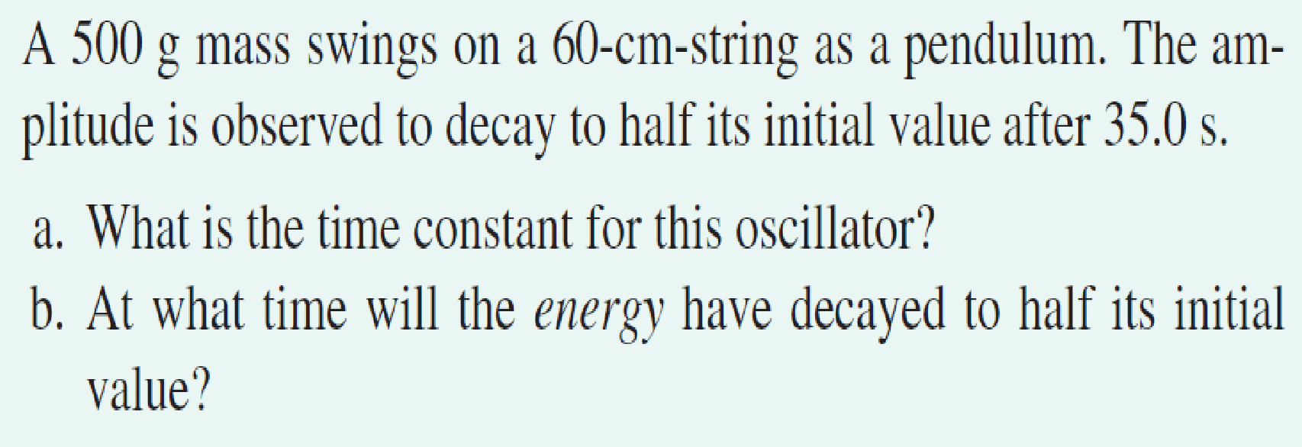

Slide 14
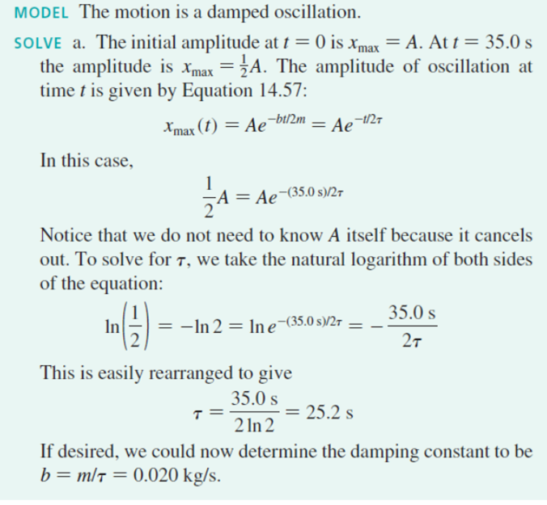

Slide 15

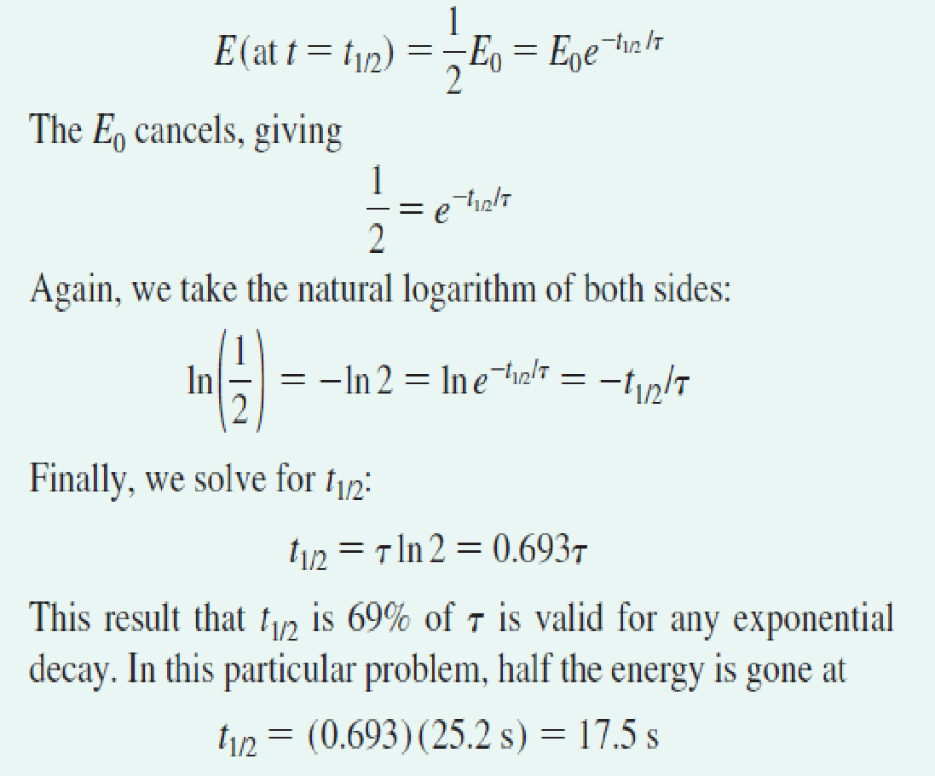

Slide 16
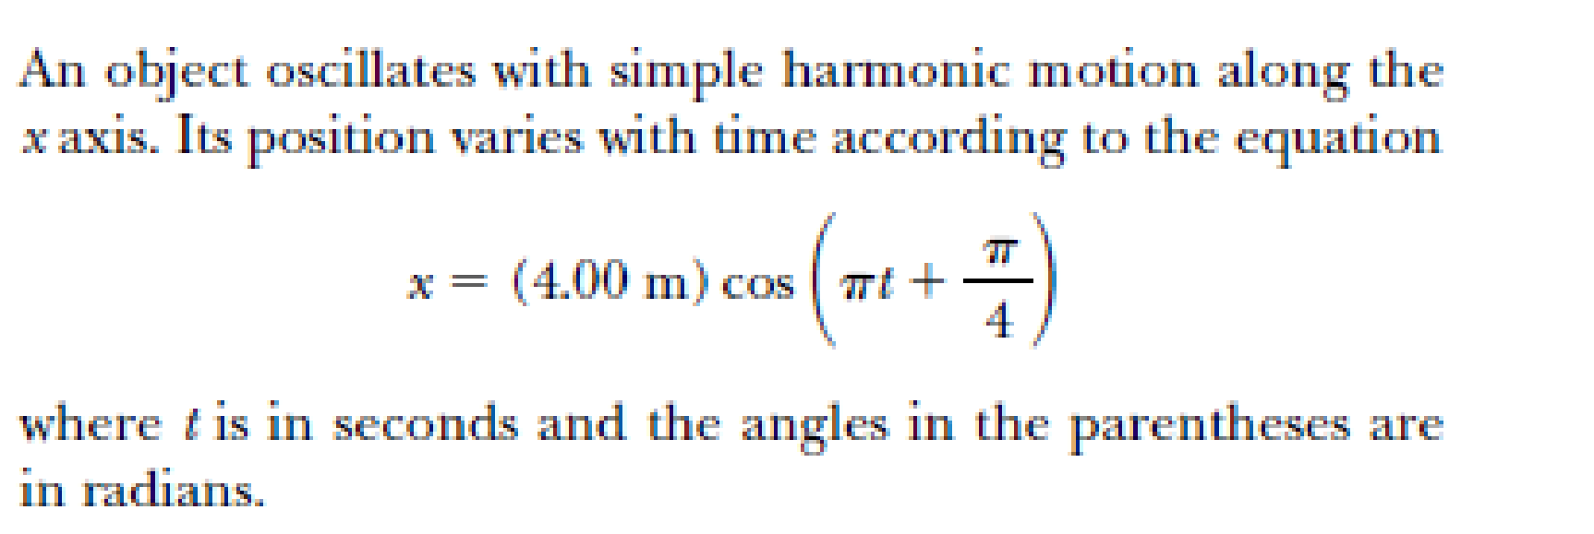

Slide 17


Slide 18


Slide 19
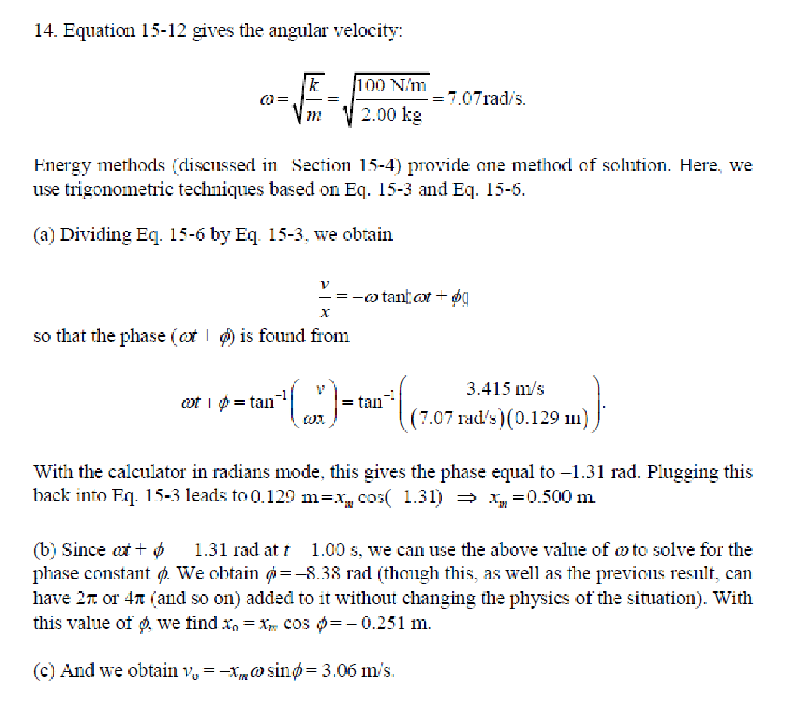

Slide 20


Slide 21


Slide 22
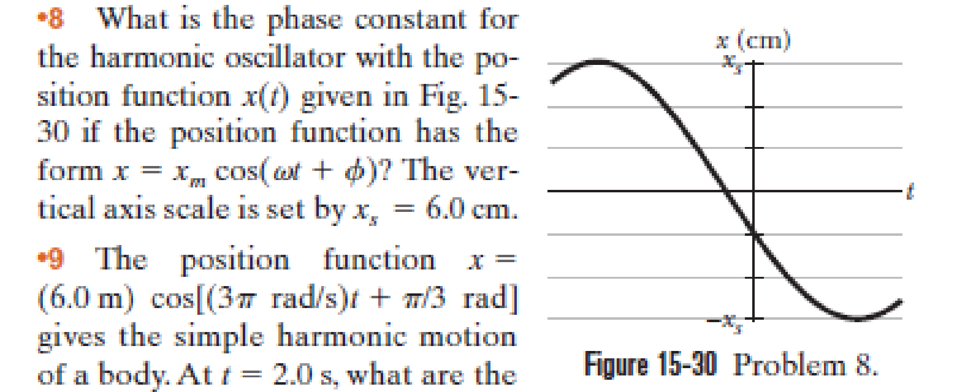

Slide 23


Slide 24


Slide 25
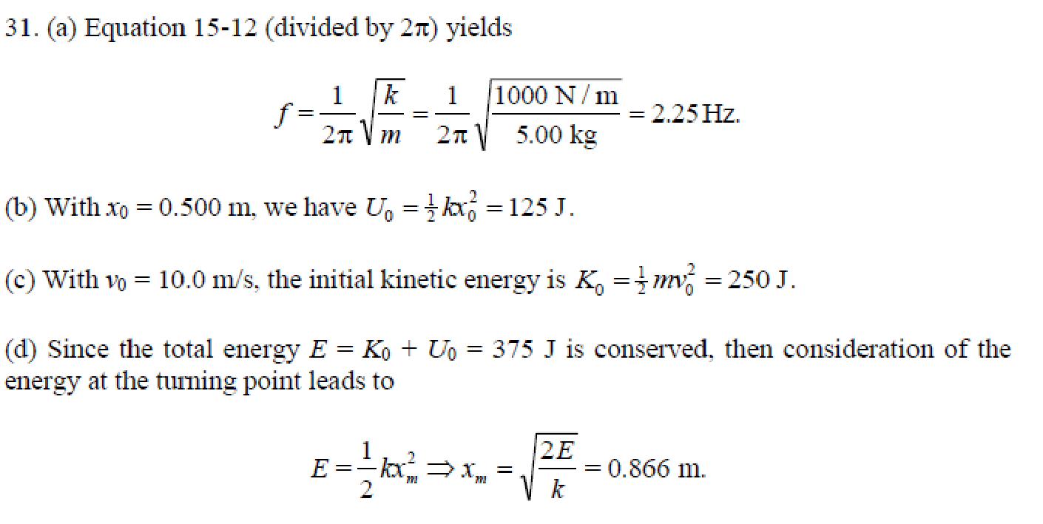

Slide 26
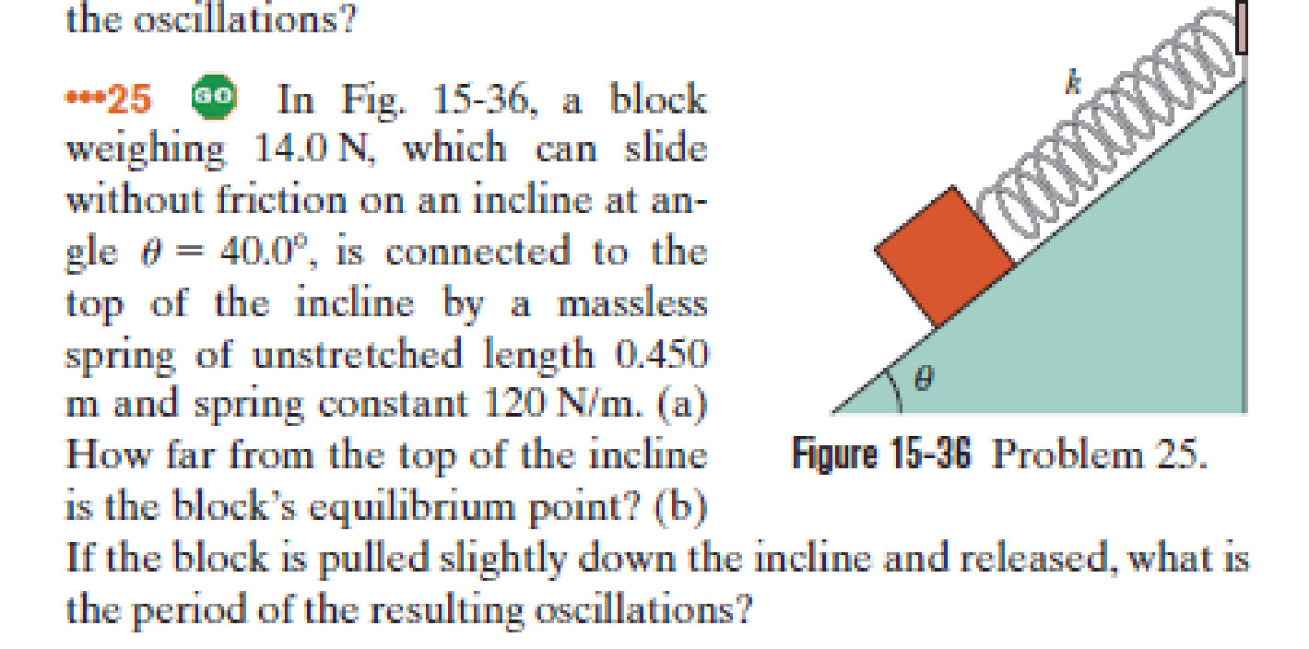

Slide 27
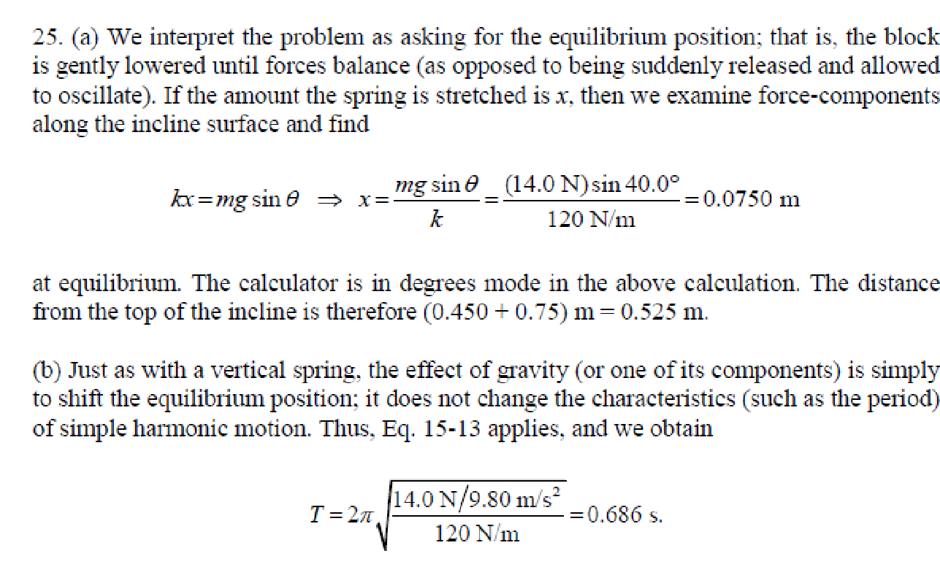

Slide 28
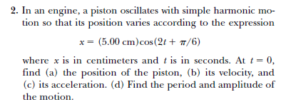

Problems solving

Slide 29



Slide 30

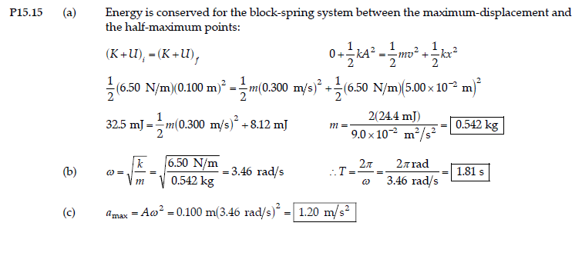

Slide 31



Slide 32
